Slide 1
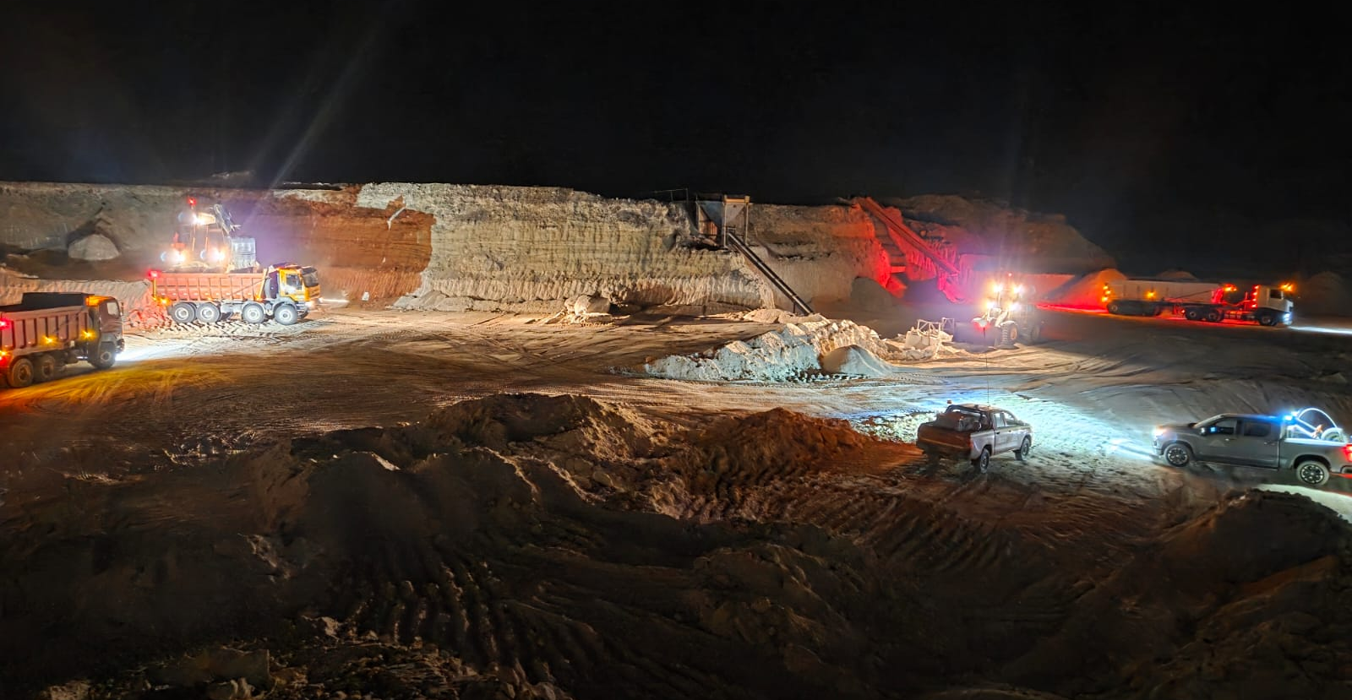

CERRO BLANCO MINING COMPANY
Calcium Carbonate Expansion Project
Operating Industrial Mineral Producer — Expansion Capital Opportunity
  Operating calcium carbonate mine in Chile
  Existing industrial customers and revenue
  Phase I expansion increases production 4×
  Defined resource with significant scale potential

Slide 2
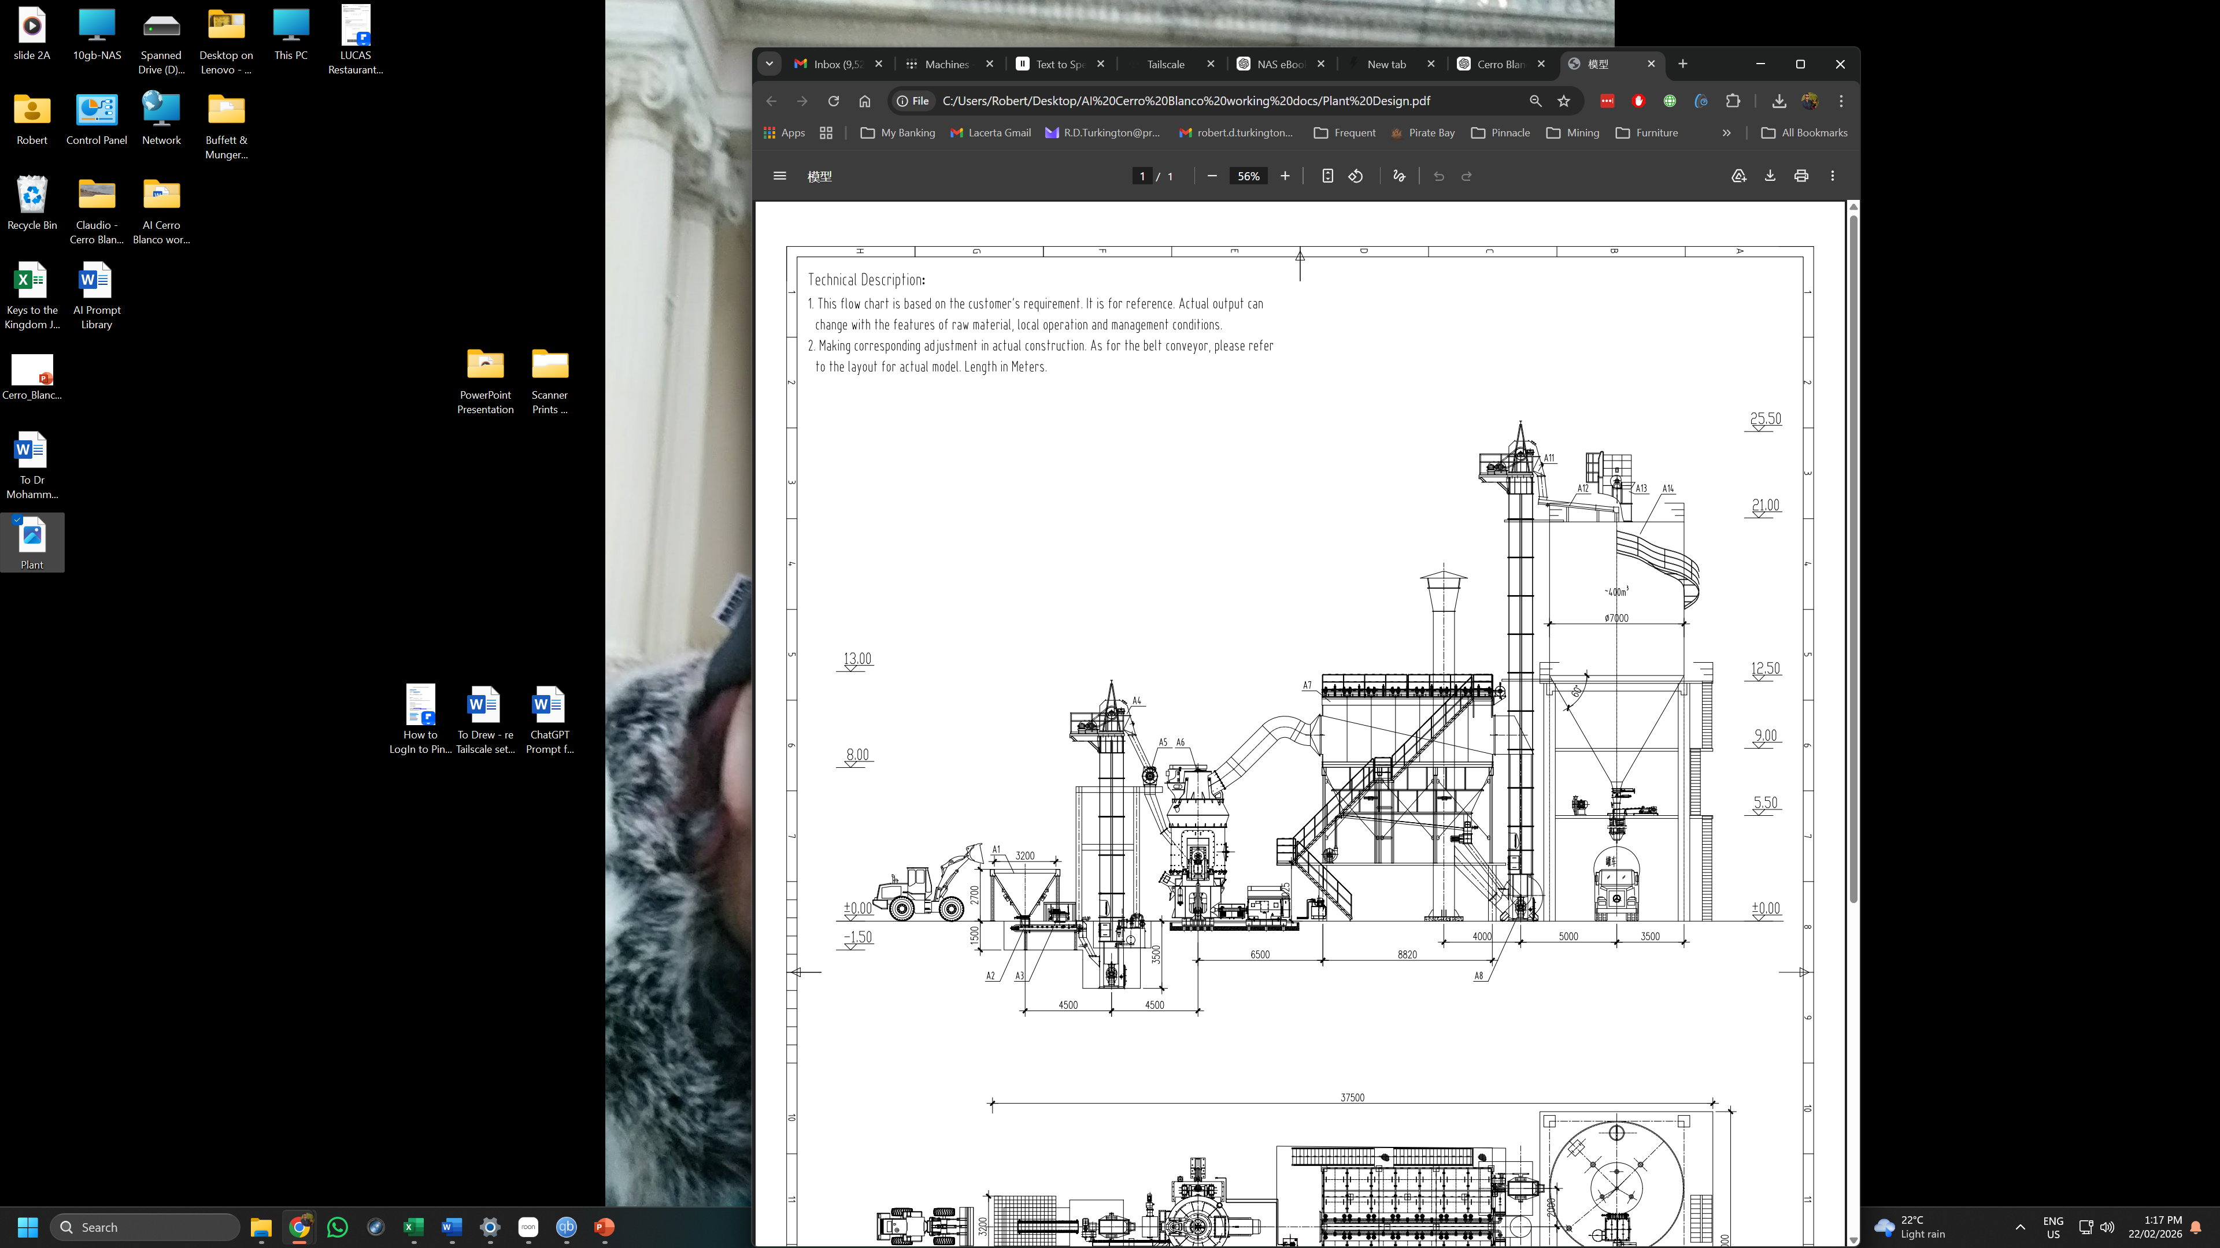
Investment Thesis
Growth Capital, Not Exploration Risk
Existing operating mine with commercial sales
US$12M expansion unlocks major production growth
Processing plant converts volume into higher margins
Large resource base supports long-term scale

Slide 3
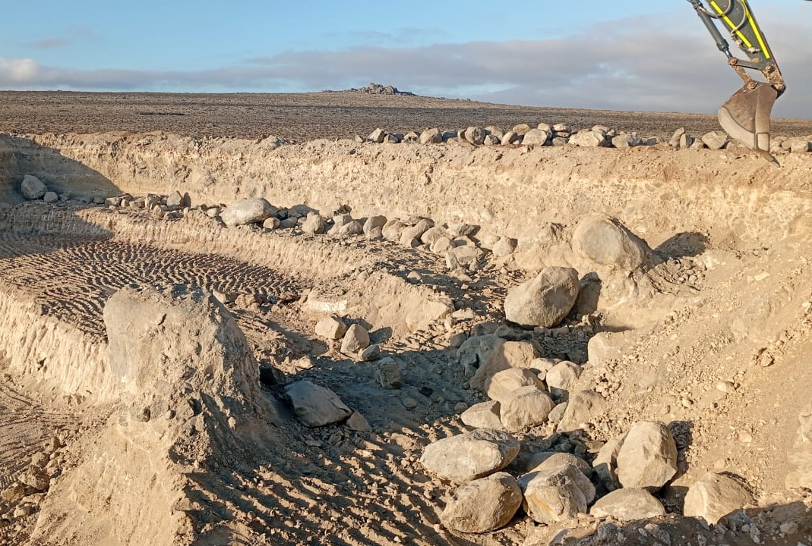
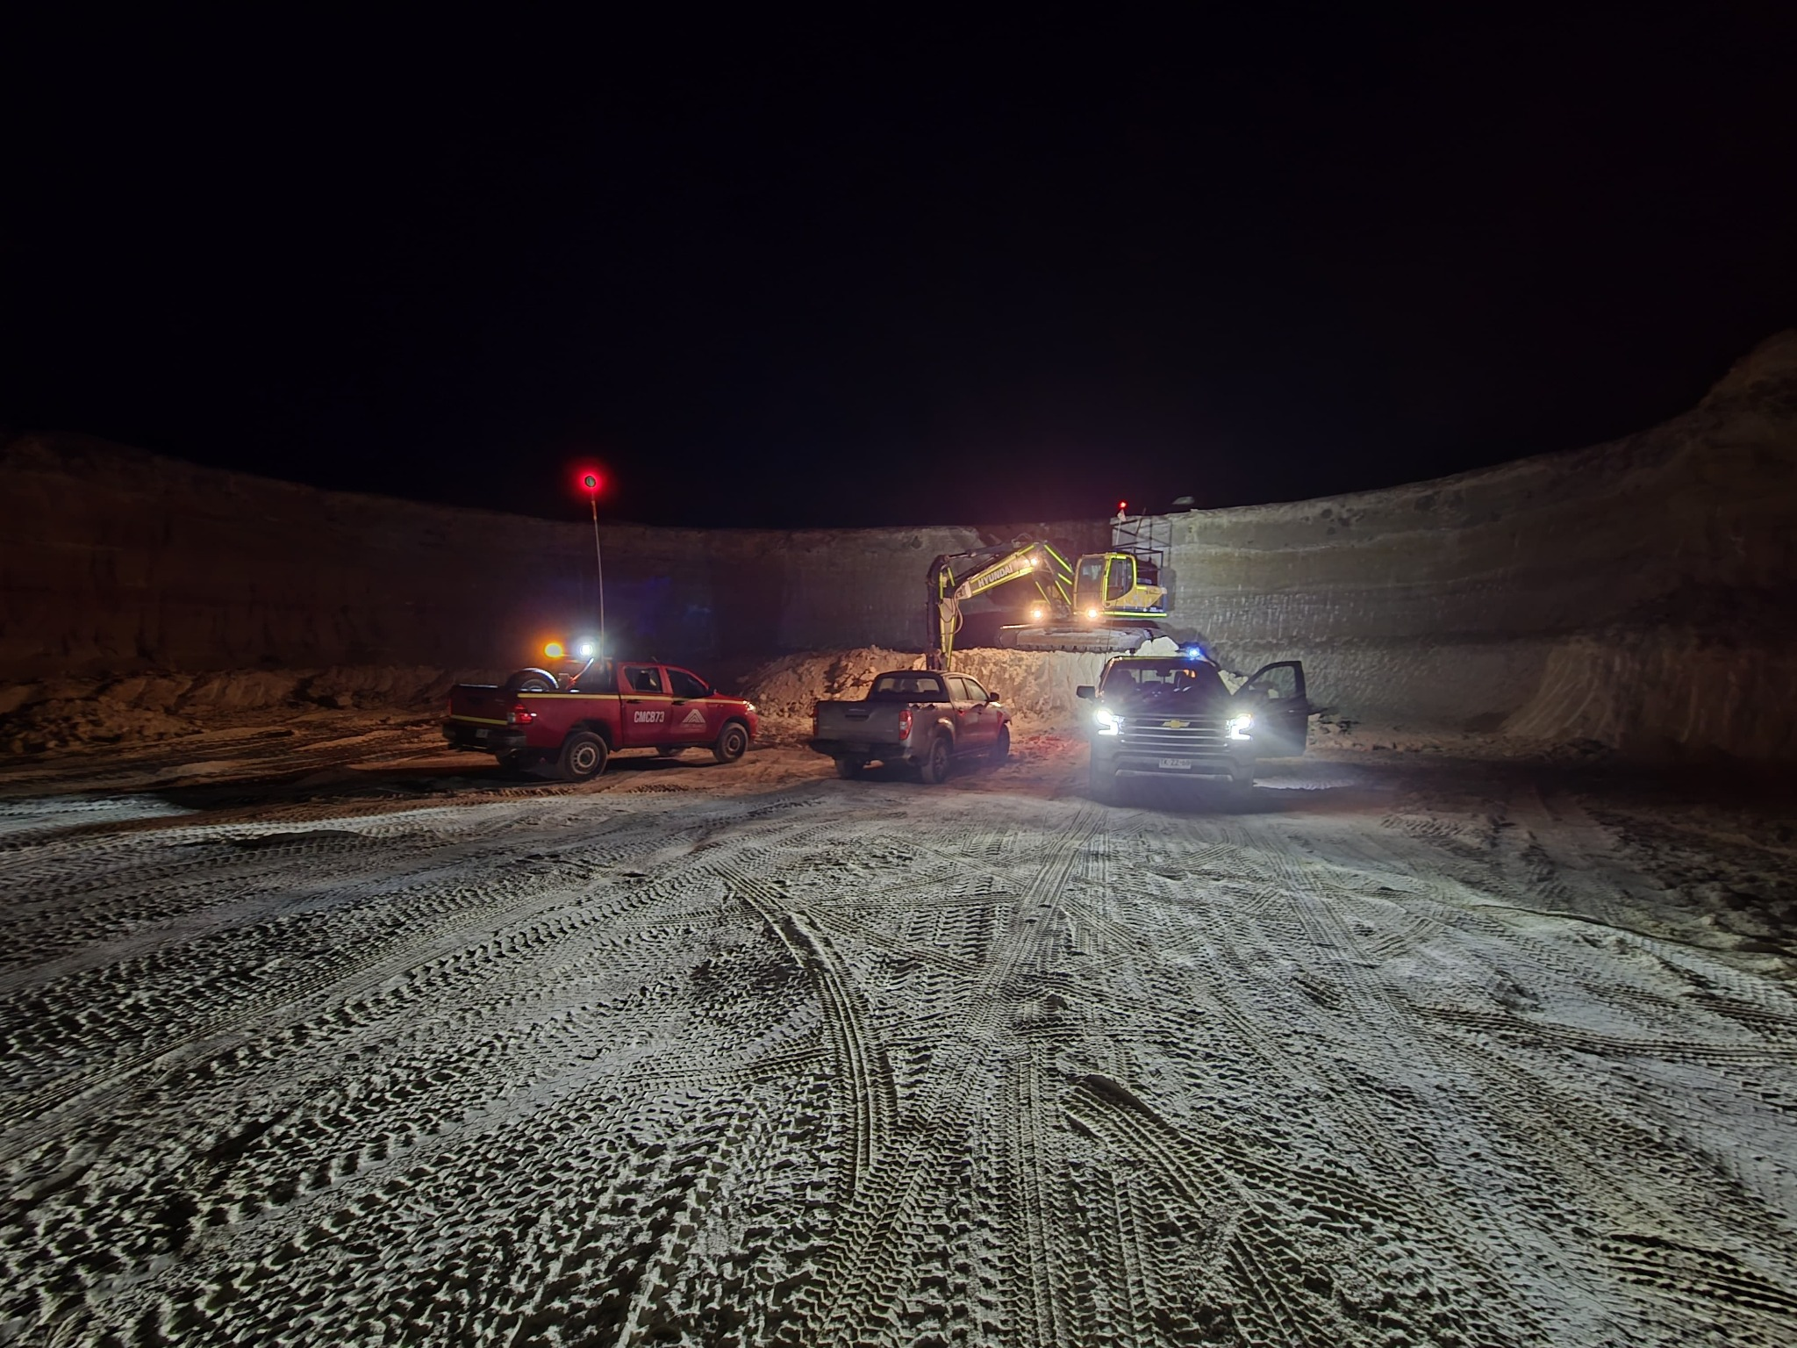
Operating Asset = Proven Execution
Current production approximately 12,000 tons per month
Active extraction and logistics
Industrial customer supply already underway

Slide 4
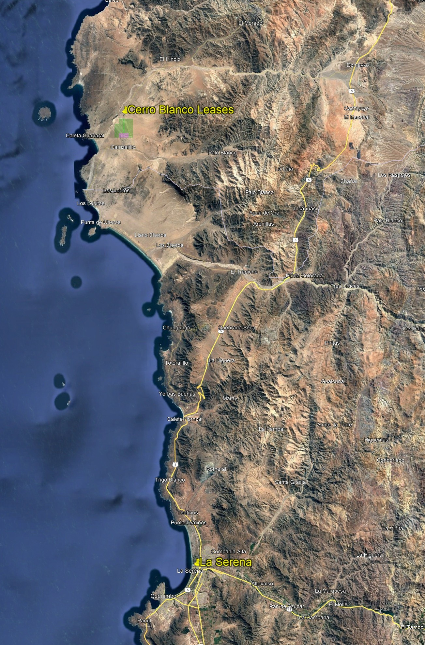
Strategic Location — Central Chile
Located approximately 122 km north of La Serena
Direct access via Pan-American Highway
Close proximity to industrial customers
Mining concessions include Carolina 1–200

Slide 5
Geological Foundation
High Purity Calcium Carbonate
Marine sedimentary deposit (Coquinas Blancas & Pardas)
Independent geological modelling completed (JORC standard)
12 drill holes confirm continuity
High-grade industrial mineral suitable for multiple industries

Slide 6
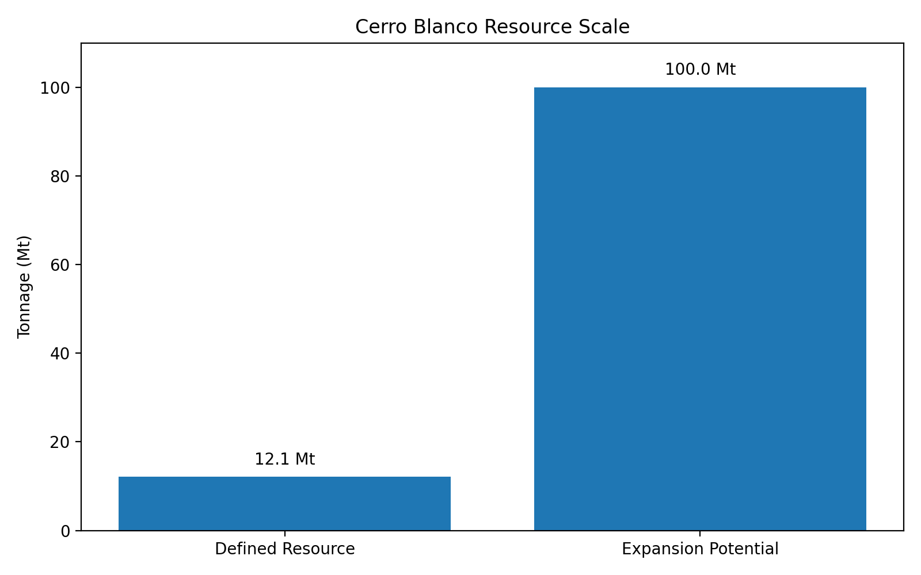
Resource Scale — Platform Opportunity
Defined Resource
Coquinas Blancas: 9.4 Mt
Coquinas Pardas: 2.75 Mt
Total defined resource over 65Ha: approximately 12.1 Mt
Provides 15 years of production @ Phase 1 expanded levels
Expansion Potential
Greater than 180 Mt indicated across 1,500 area of Leases provides limitless supply
Drives potential for diversification of upstream processing

Slide 7
Local Industrial Calcium Carbonate Demand
Primary sectors:
  Glass manufacturing
  Mining and metallurgy
  Agriculture
  Cement and industrial fillers
Demand exists today — production capacity is the constraint.
Detailed Chilean Market Analysis available to genuine enquirers.

Slide 8
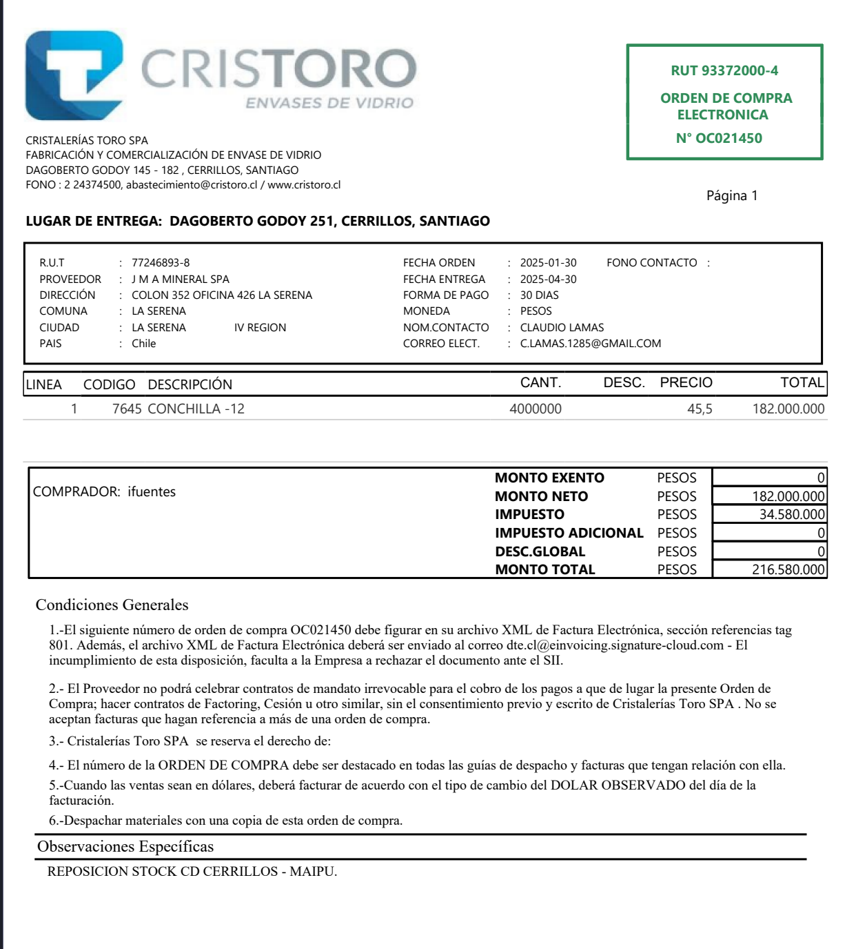
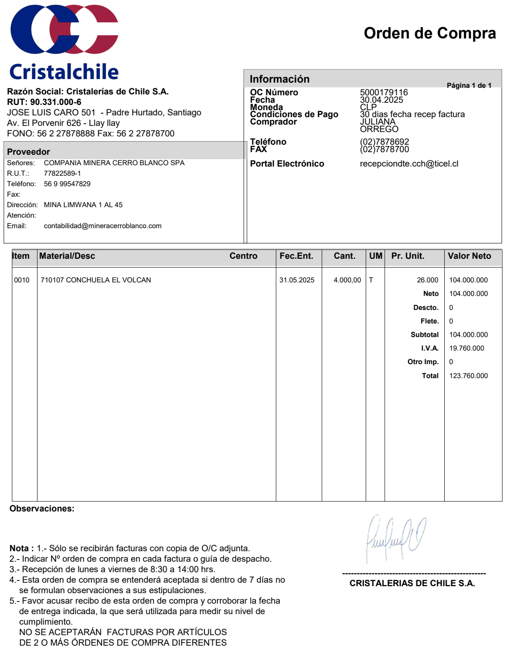
Substantial Existing Industrial Customers
Purchase orders from CrisToro
Purchase orders from CristalChile
Supply contracts with Chilean glass producers
Contract with CAP being finalized
Secure cash flow from substantial customers
Huge Customer demand supports expansion
Industrial market already established

Slide 9
Processing Plant — Margin Expansion Engine
Crushing and grinding circuit
Magnetic separation reduces iron content
Enables premium fines product
High degree of materials handling automation
Simple Scalable engineering design

Slide 10
VALUE TRANSFORMATION
From Volume to Value
Current Product
Lump calcium carbonate
Post Expansion
Premium fines product
Higher purity
Expanded industrial applications
Greatly improved pricing and margins

Slide 11
PRODUCTION EXPANSION
Production Growth
Current production: 12,000 tpm
Capital constrained
Phase I production: 40,000 tpm
Over 330% increase in production capacity.
Discussions underway with Mines Department for hugely increased mining permit (over 100,000 tpm) including environmentally focused upstream processing facility.

Slide 12
CAPITAL DEPLOYMENT
Expansion Capital — US$12 Million
Efficient Capital allocation:
  Multiple processing plant purchases& installation
  Materials handling equipment expansion
  Working capital
  Further Geological study to define substantially greater resource availability driving increased production over increased lifetime and higher asset valuation.

Slide 13
FINANCIAL GROWTH PROFILE
Financial Growth Potential
Significant revenue growth post commissioning
Operating leverage from higher throughput
Margin uplift from fines product
Strong projected cash generation;
  ~ US$9 million NPAT current calendar year
  ~ US$15 million NPAT subsequent full year
Substantial ore-body supports future production expansion (15 years at forecast production levels)

Slide 14
RISK MITIGATION
De-Risked Growth Profile
    Successfully operating business
    Proven extraction capability
    Highly qualified and experienced local owner
    Fully owned mining leases
    Existing substantial customers
    Defined geological resource (15 years @ forecast production)
    Simple and easily expanded modular plant installation

Slide 15
STRATEGIC POSITIONING
Highly Strategic Industrial Supply Platform
  Supports Chilean glass industry
  Growing Mining and metallurgical demand
  Critical Agricultural applications
  Future quicklime expansion potential – scarce but essential processing input for largest Copper producing country.

Slide 16
DEVELOPMENT TIMELINE
Fast Track to Expanded Production
  Engineering Completed and procurement phase ready
  Plant installation (~4 weeks)
  Commissioning (~2 months)
  Ramp-up to full production over 2 months

Slide 17

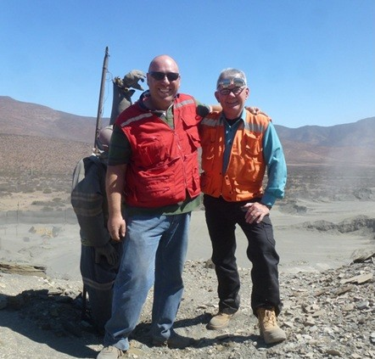
MANAGEMENT & ADVISORS
Demonstrated Leadership and Advisory Team
Minera Cerro Blanco SpA
Claudio Lamas
Founder & Mining Engineer
Pinnacle Equities Pty Ltd
Robert Turkington — Advisor (Australia)
Juan Dagach — Operations & Plant Specialist (Chile)

Slide 18
INVESTMENT SUMMARY
Strong Investment Case — Strong Growth Narrative
Operating asset with substantial expansion upside
Significant production and margin growth
Large resource base supports long-term value
Suitable for funds, development finance and strategic partnerships

Slide 19
CONTACT
Next Steps
Cía. Minera Cerro Blanco SpA
Advisor: Pinnacle Equities Pty Ltd
Robert Turkington — Australia
Email: Robert.Turkington@pinnaclequities.com
Extensive technical and financial data available for due diligence.

